Slide 1
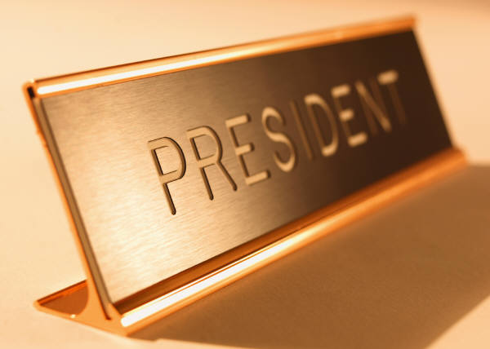
Unit 5
Mastery Project

Slide 2
Identify and explain the organization of the Executive
The role of the Executive is to enforce the law. The organization gives no clear organization to the Executive branch. There are executive departments which is the basis for the cabinet. The president relies mainly on his White House staff for advice and a president turns to the cabinet for expertise advice.

Slide 3
Identify and provide an example of the powers of the Executive, both formal and informal.
The formal powers of the president are he can act as administrative head of the nation, serve as commander-in-chief of the military, convene congress, veto legislation, appoint top officials, make treaties, and grant pardons. The informal powers of the president is his ability to set the legislative agenda and set economic policy.

Slide 4
Identify and explain how Executive shares powers with the Congress, Judiciary, and bureaucracy.
The executive branch and Congress share the powers of declaring war, passing a bill, and dealing with foreign issues. The executive branch and judiciary share the powers by the president appoints the officials for the judiciary branch. The executive branch and bureaucracy share powers because the bureaucracy is made up of departments that directly work with the president.

Slide 5
Discuss the implications of Executive sharing powers with each of the following: Congress, Judiciary, and bureaucracy.
The implications of the Executive branch is to make sure that the president does not gain to much power. It keeps the people connected to the government and it stops the executive branch from being to powerful. It keeps the branch in check and in touch with the people.

Slide 6
Discuss the functions that Executive performs.
The functions of the Executive are it can veto a bill(overturned with 2/3 vote), grant pardons, make treaties with foreign nations(subject to Senate approval), Appoint top officials, act as administrative head of the nation, serve as commander-in-chief to the military, and Convene Congress.

Slide 7
Identify how the power of the Executive has/may evolve gradually.
The powers of the Executive branch evolve gradually over time because as the nation evolves then the powers of the president need to evolve to deal with all the issues caused by the growth of the new world. M0re powers are added to the inherent powers to deal with all the problems.

Slide 8
Identify how the power of the Executive has/may changes dramatically as a result of crisis.
During a time of crisis it is common for the president to gain the powers of the Congress in order to act faster and better to the situation. The president gets the Delegated Powers but after the crisis is solved then Congress gets their powers back.

Slide 9
Identify and discuss the ties between the Executive and political parties.
The president is the head of the political party and is considered the “fundraiser and chief” for his party. The president is the Party Leader and helps gain support and money for the party.

Slide 10
Identify and discuss the ties between the Executive and interest groups.
The ties of the Executive branch and interest groups is the interest groups helped get the president elected which in return the president is supposed to get the groups ideas and issues on the political agenda.

Slide 11
Identify and discuss the ties between the Executive and media.
The media always tries to make the president look bad by catching him do something bad. It is called Watchdog media. The media uses horse-race journalism, it is the every day to day things that the president does.

Slide 12
Identify and discuss the ties between the Executive and state and local governments.
The state and local governments have t0 0bey the orders of the Executive branch. The Executive branch can give grants to the state and local governments which can be either used freely or for a specific purpose.

